Slide 1
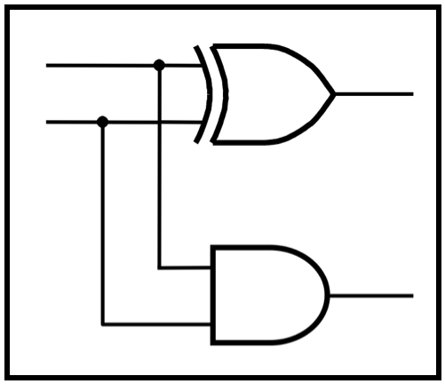
CprE 281:
Digital Logic
Instructor: Alexander Stoytchev
http://www.ece.iastate.edu/~alexs/classes/

Slide 2
Counters & Solved Problems
CprE 281: Digital Logic
Iowa State University, Ames, IA
Copyright © 2013

Slide 3
Administrative Stuff
Homework 9 is out
It is due on Monday Nov 7, 2016

Slide 4
Counters

Slide 5
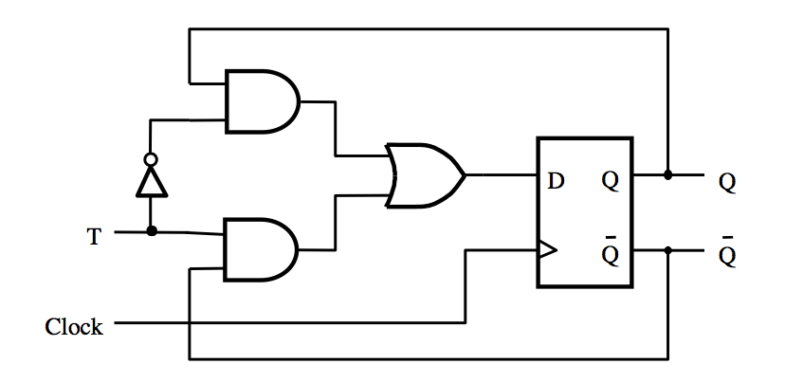
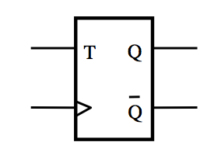
T Flip-Flop
(circuit and graphical symbol)
[ Figure 5.15a,c from the textbook ]

Slide 6
The output of the T Flip-Flop
divides the frequency of the clock by 2

Slide 7
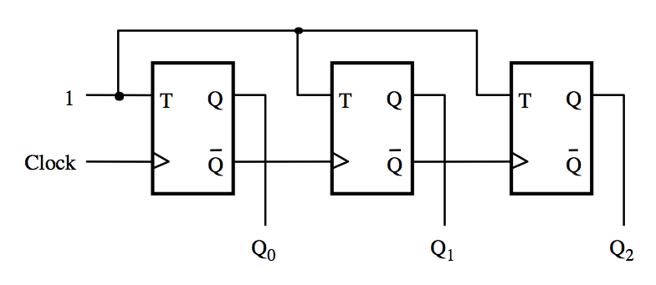
A three-bit up-counter
[ Figure 5.19 from the textbook ]

Slide 8
A three-bit up-counter
The first flip-flop changes
on the positive edge of the clock
[ Figure 5.19 from the textbook ]

Slide 9
A three-bit up-counter
The first flip-flop changes
on the positive edge of the clock
The second flip-flop changes
on the positive edge of Q₀
[ Figure 5.19 from the textbook ]

Slide 10
A three-bit up-counter
The first flip-flop changes
on the positive edge of the clock
The second flip-flop changes
on the positive edge of Q₀
The third flip-flop changes
on the positive edge of Q₁
[ Figure 5.19 from the textbook ]

Slide 11
A three-bit up-counter
1
T
Q
T
Q
T
Q
Clock
Q
Q
Q
Q
Q
Q
0
1
2
(a) Circuit
Clock
Q
0
Q
1
Q
2
Count
0
1
2
3
4
5
6
7
0
(b) Timing diagram
[ Figure 5.19 from the textbook ]

Slide 12
A three-bit up-counter
1
T
Q
T
Q
T
Q
Clock
Q
Q
Q
Q
Q
Q
0
1
2
The propagation delays get longer
(a) Circuit
Clock
Q
0
Q
1
Q
2
Count
0
1
2
3
4
5
6
7
0
(b) Timing diagram
[ Figure 5.19 from the textbook ]

Slide 13
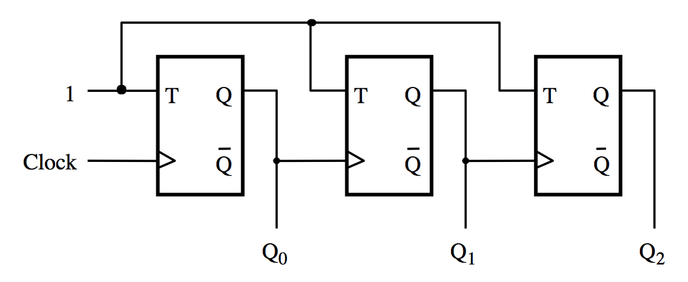
A three-bit down-counter
[ Figure 5.20 from the textbook ]

Slide 14
A three-bit down-counter
1
T
Q
T
Q
T
Q
Clock
Q
Q
Q
Q
Q
Q
0
1
2
(a) Circuit
Clock
Q
0
Q
1
Q
2
Count
0
7
6
5
4
3
2
1
0
(b) Timing diagram
[ Figure 5.20 from the textbook ]

Slide 15
Synchronous Counters

Slide 16
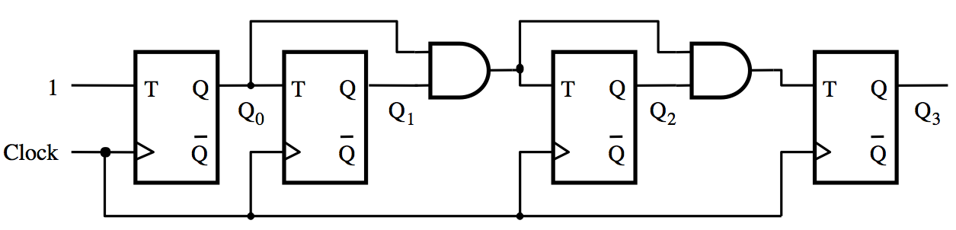
A four-bit synchronous up-counter
[ Figure 5.21 from the textbook ]

Slide 17
A four-bit synchronous up-counter
The propagation delay through all AND gates combined must
not exceed the clock period minus the setup time for the flip-flops
[ Figure 5.21 from the textbook ]

Slide 18
A four-bit synchronous up-counter
1
T
Q
T
Q
T
Q
T
Q
Q
0
Q
1
Q
2
Q
3
Clock
Q
Q
Q
Q
(a) Circuit
Clock
Q
0
Q
1
Q
2
Q
3
Count
0
1
2
3
4
5
6
7
8
9
10
11
12
13
14
15
0
1
(b) Timing diagram
[ Figure 5.21 from the textbook ]

Slide 19
Derivation of the synchronous up-counter
Clock cycle
Q
2
Q
1
Q
0
Q
changes
0
0
0
0
1
Q
changes
1
0
0
1
2
2
0
1
0
3
0
1
1
4
1
0
0
5
1
0
1
6
1
1
0
7
1
1
1
8
0
0
0
[ Table 5.1 from the textbook ]

Slide 20
Derivation of the synchronous up-counter
Clock cycle
Q
2
Q
1
Q
0
Q
changes
0
0
0
0
1
Q
changes
1
0
0
1
2
2
0
1
0
3
0
1
1
4
1
0
0
5
1
0
1
6
1
1
0
7
1
1
1
8
0
0
0
T₀= 1
T₁ = Q₀
T₂ = Q₀ Q₁
[ Table 5.1 from the textbook ]

Slide 21
A four-bit synchronous up-counter
T₀= 1
T₁ = Q₀
T₂ = Q₀ Q₁
[ Figure 5.21 from the textbook ]

Slide 22
In general we have
T₀= 1
T₁ = Q₀
T₂ = Q₀ Q₁
T₃ = Q₀ Q₁ Q₂
…
T_{n} = Q₀ Q₁ Q₂ …Q_{n-1}

Slide 23
Adding Enable and Clear Capability

Slide 24
Inclusion of Enable and Clear capability
Enable
T
Q
T
Q
T
Q
T
Q
Clock
Q
Q
Q
Q
Clear_n
[ Figure 5.22 from the textbook ]

Slide 25
Inclusion of Enable and Clear capability
This is the new thing relative to
the previous figure, plus the clear_n line
Enable
T
Q
T
Q
T
Q
T
Q
Clock
Q
Q
Q
Q
Clear_n
[ Figure 5.22 from the textbook ]

Slide 26
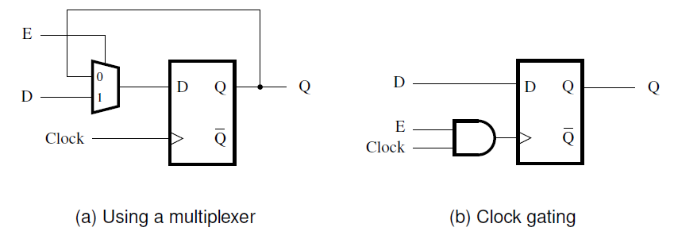
Providing an enable input for a D flip-flop
[ Figure 5.56 from the textbook ]

Slide 27
Synchronous Counter with D Flip-Flops

Slide 28
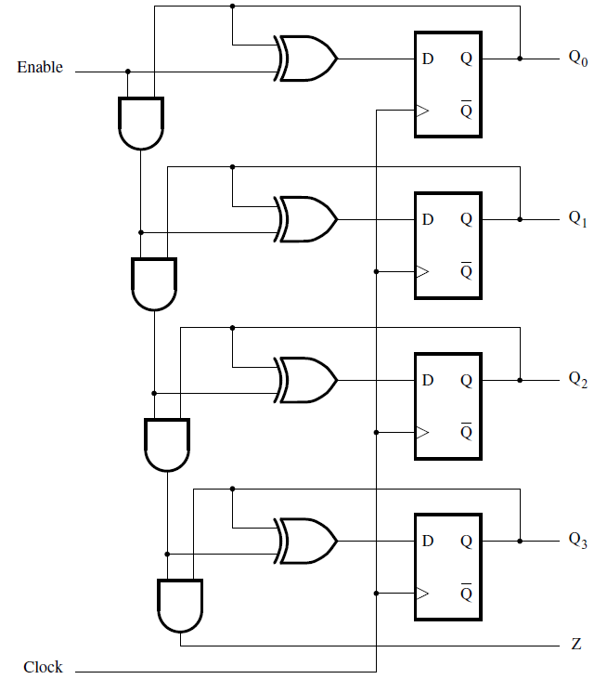
A four-bit counter with D flip-flops
[ Figure 5.23 from the textbook ]

Slide 29
Counters with Parallel Load

Slide 30
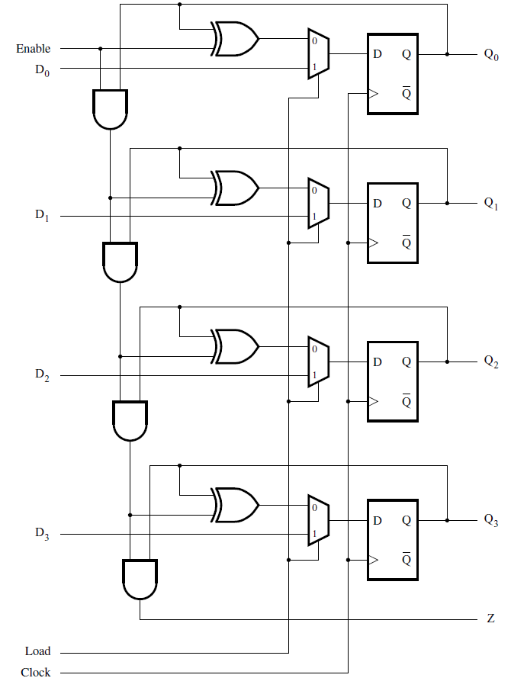
A counter with parallel-load capability
[ Figure 5.24 from the textbook ]

Slide 31
Reset Synchronization

Slide 32
Motivation
An n-bit counter counts from 0, 1, …, 2^{n}-1
For example a 3-bit counter counts up as follow
  0, 1, 2, 3, 4, 5, 6, 7, 0, 1, 2, …
What if we want it to count like this
  0, 1, 2, 3, 4, 5, 0, 1, 2, 3, 4, 5, 0, 1, …
In other words, what is the cycle is not a power of 2?

Slide 33
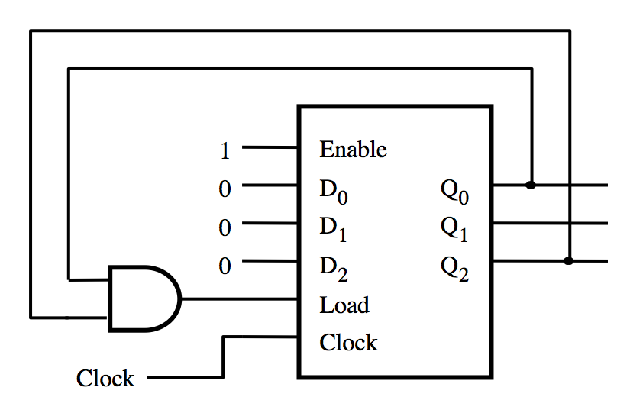
What does this circuit do?
[ Figure 5.25a from the textbook ]

Slide 34
A modulo-6 counter with synchronous reset
1
Enable
0
D
Q
0
0
0
D
Q
1
1
0
D
Q
2
2
Load
Clock
Clock
(a) Circuit
Clock
Q
0
Q
1
Q
2
Count
0
1
2
3
4
5
0
1
(b) Timing diagram
[ Figure 5.25 from the textbook ]

Slide 35
A modulo-6 counter with asynchronous reset
1
T
Q
T
Q
T
Q
Q
0
Q
1
Q
2
Clock
Q
Q
Q
(a) Circuit
Clock
Q
0
Q
1
Q
2
Count
0
1
2
3
4
5
0
1
2
(b) Timing diagram
[ Figure 5.26 from the textbook ]

Slide 36
A modulo-6 counter with asynchronous reset
1
T
Q
T
Q
T
Q
Q
0
Q
1
Q
2
Clock
Q
Q
Q
(a) Circuit
The number 5 is displayed
for a very short amount of time
Clock
Q
0
Q
1
Q
2
Count
0
1
2
3
4
5
0
1
2
(b) Timing diagram
[ Figure 5.26 from the textbook ]

Slide 37
Other Types of Counters
(Section 5.11)

Slide 38
A two-digit BCD counter
2: Parallel-load four-bit counter
  Figure 5.24
Each counts in binary
  0-9
Resets generated on 9
  Reset by loading 0’s
Second digit enabled by a 9 on first counter

Slide 39
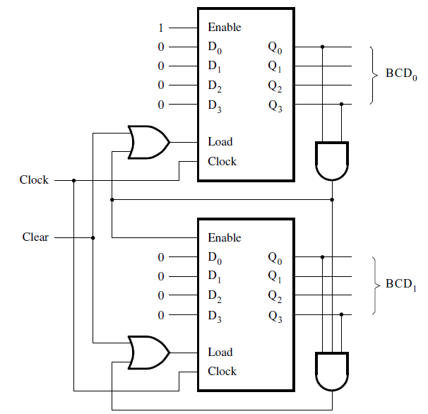
A two-digit BCD counter
[ Figure 5.27 from the textbook ]

Slide 40
A two-digit BCD counter
What is this?
[ Figure 5.27 from the textbook ]

Slide 41
It is a counter with parallel-load capability
[ Figure 5.24 from the textbook ]

Slide 42
A two-digit BCD counter

Slide 43
Zeroing the BCD counter
1
1
1
1
1
Setting "Clear" to 1,
zeroes both counters.
[ Figure 5.27 from the textbook ]

Slide 44
Zeroing the BCD counter
0
0
0
0
0
1
1
1
0
0
0
0
0
1
1
Setting "Clear" to 1,
zeroes both counters.
[ Figure 5.27 from the textbook ]

Slide 45
How to zero a counter
0
0
0
0
Set all parallel load
input lines to zero.
[ Figure 5.24 from the textbook ]

Slide 46
How to zero a counter
0
0
0
0
0
0
0
0
Set "Load" to 1, to open the
"1" line of the multiplexers.
1
[ Figure 5.24 from the textbook ]

Slide 47
How to zero a counter
0
0
0
0
0
0
0
0
0
0
0
0
When the positive edge of the
clock arrives, all outputs
are set to zero together.
1
[ Figure 5.24 from the textbook ]

Slide 48
When Clear = 0
0
0
0
When "Clear" is equal to 0,
the two OR gates depend only
on the feedback connections.
[ Figure 5.27 from the textbook ]

Slide 49
Enabling the second counter
[ Figure 5.27 from the textbook ]

Slide 50
Enabling the second counter
0
0
0
0
0
0
0
0
0
0
0
0
The counter for the most
significant digit is disabled
most of the time.

Slide 51
Enabling the second counter
1
1
0
0
0
0
0
0
0
0
0
0
The counter for the most
significant digit is disabled
most of the time.

Slide 52
Enabling the second counter
2
0
1
0
0
0
0
0
0
0
0
0
The counter for the most
significant digit is disabled
most of the time.

Slide 53
Enabling the second counter
3
1
1
0
0
0
0
0
0
0
0
0
The counter for the most
significant digit is disabled
most of the time.

Slide 54
Enabling the second counter
4
0
0
1
0
0
0
0
0
0
0
0
The counter for the most
significant digit is disabled
most of the time.

Slide 55
Enabling the second counter
5
1
0
1
0
0
0
0
0
0
0
0
The counter for the most
significant digit is disabled
most of the time.

Slide 56
Enabling the second counter
6
0
1
1
0
0
0
0
0
0
0
0
The counter for the most
significant digit is disabled
most of the time.

Slide 57
Enabling the second counter
7
1
1
1
0
0
0
0
0
0
0
0
The counter for the most
significant digit is disabled
most of the time.

Slide 58
Enabling the second counter
8
0
0
0
1
0
0
0
0
0
0
0
The counter for the most
significant digit is disabled
most of the time.

Slide 59
Enabling the second counter
9
1
0
0
1
1
1
0
0
0
0
0
It is enabled only when
the first counter is at 9.

Slide 60
Enabling the second counter
9
1
0
0
1
1
1
1
0
0
0
0
0
At the same time the first
counter is reset.

Slide 61
Enabling the second counter
0
0
0
0
0
0
0
0
1
1
0
0
0
At the same time the first
counter is reset.

Slide 62
Enabling the second counter
1
1
0
0
0
0
0
0
1
1
0
0
0

Slide 63
Enabling the second counter
2
0
1
0
0
0
0
0
1
1
0
0
0

Slide 64
. . .

Slide 65
Enabling the second counter
8
0
0
0
1
0
0
0
1
1
0
0
0

Slide 66
Enabling the second counter
9
1
0
0
1
1
1
1
1
1
0
0
0

Slide 67
Enabling the second counter
0
0
0
0
0
0
0
0
2
0
1
0
0

Slide 68
Enabling the second counter
1
1
0
0
0
0
0
0
2
0
1
0
0

Slide 69
. . .

Slide 70
Enabling the second counter
8
0
0
0
1
0
0
0
9
1
0
0
1

Slide 71
Enabling the second counter
9
1
0
0
1
1
1
1
9
1
0
0
1

Slide 72
Enabling the second counter
9
1
0
0
1
1
1
1
9
1
0
0
1
1
1

Slide 73
Enabling the second counter
0
0
0
0
0
0
0
0
0
0
0
0
0
0
0

Slide 74
Enabling the second counter
1
1
0
0
0
0
0
0
0
0
0
0
0
0
0

Slide 75
N-bit ring counter
  1000, 0100, 0010, 0001, 1000…….
  Reset
    Set start to 1
    Sets output to 1000

Slide 76
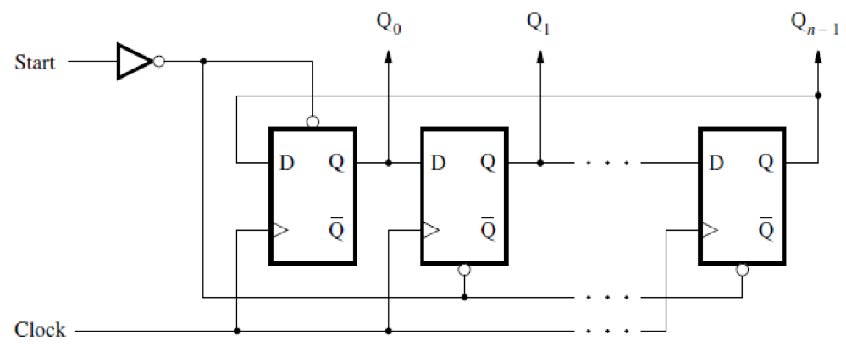
N-bit ring counter
[ Figure 5.28a from the textbook ]

Slide 77
4-bit ring counter
  Use a 2-bit counter
    00, 01, 10, 11, 00……..
  2-4 Decoder
    1000, 0100, 0010, 0001, 1000……..

Slide 78
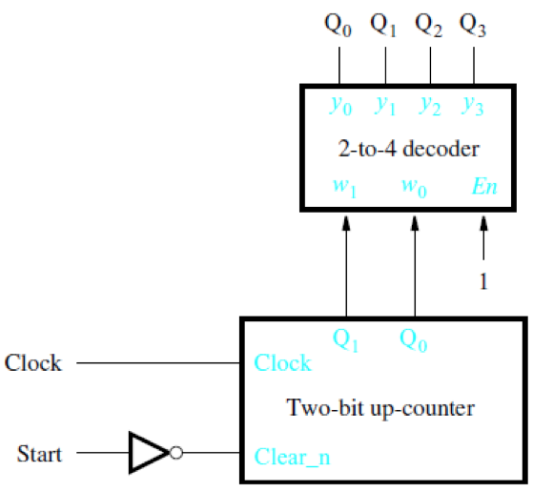
4-bit ring counter
[ Figure 5.28b from the textbook ]

Slide 79
Johnson Counter
  1-bit changes at a time
  0000, 1000, 1100, 1110, 1111, 0111, 0011, 0001, 0000
  Begin with a reset of all flip-flops
  An n-bit Johnson counter has a counting sequence of length 2n

Slide 80
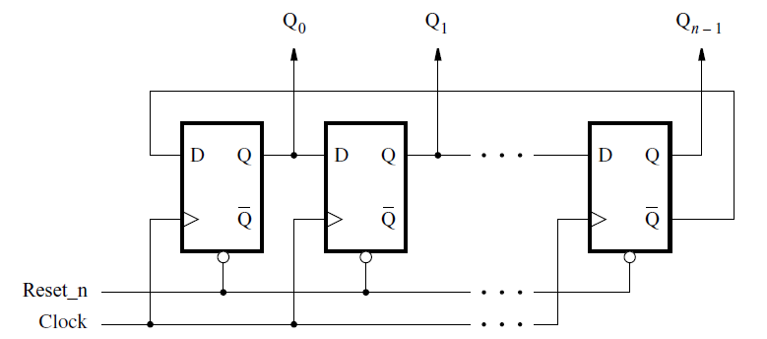
Johnson counter
[ Figure 5.29 from the textbook ]

Slide 81
Timing Analysis of Flip-Flop Circuits
(Section 5.15)

Slide 82
Timing Review
tsu: setup time
th: hold time
tcQ: propogation delay

Slide 83
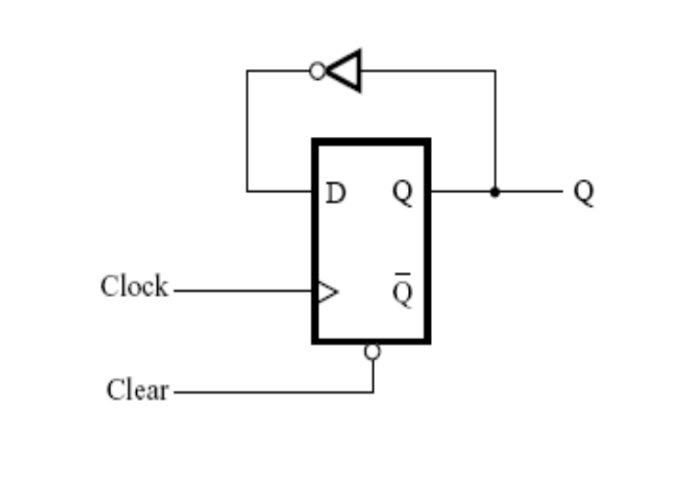
Timing Example
tsu: 0.6ns
th: 0.4ns
tcQ: 0.8ns to 1.0ns
  Which value to use?
Logic gate delay: 1+0.1k
  k is equal to the number of inputs
Tmin = tsu + tcQ + tnot = 0.6 + 1.0 + 1.1 = 2.7ns
Fmax = 1/Tmin = 370.37MHz
Check for hold violations
  Fastest Q can change = tcQ + tnot = 0.8 + 1.1 = 1.9ns
  1.9ns > 0.4ns therefore no hold violations

Slide 84
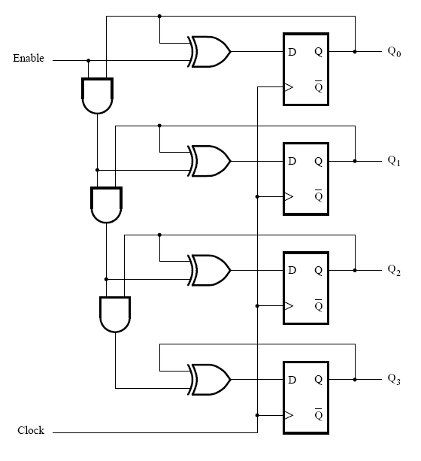
Timing Example: 4-bit counter
[ Figure 5.67 from the textbook ]

Slide 85
Timing Example: 4-bit counter
Look for longest path
  Q0 to Q3
Propagation delay of Q0
3 AND propagation delays
1 XOR propagation delay
Setup delay for Q3
Tmin = 1.0 + 3(1.2) + 1.2 + 0.6 = 6.4ns
Fmax = 1/6.4ns = 156.25MHz
Check for hold violations
  Fastest Q can change = tcQ + tXOR = 0.8 + 1.2 = 2ns
  2.0ns > 0.4ns therefore no hold violations

Slide 86
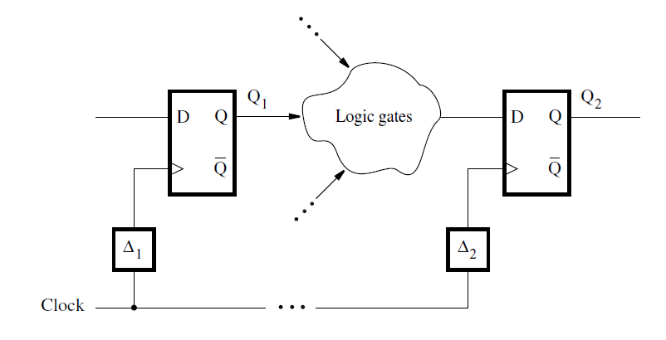
Timing Example: Clock Skew
Figure 5.68. A general example of clock skew.

Slide 87
Skew Timing Example: 4-bit counter
Q3 now has a clock slew delay: 1.5ns
  T = 1.0 + 3(1.2) + 1.2 + 0.6 - 1.5 = 4.9ns
Now might not be the longest path
Check Q0 to Q2
  T = 1.0 + 2(1.2) + 1.2 + 0.6 = 5.2ns
Fmax = 1/5.2ns = 192.31MHz

Slide 88
Example 5.22

Slide 89
Faster 4-bit Counter
Want to increase the speed of the 4-bit counter
Use similar method as used in 4-bit adder
Remove series AND gates

Slide 90
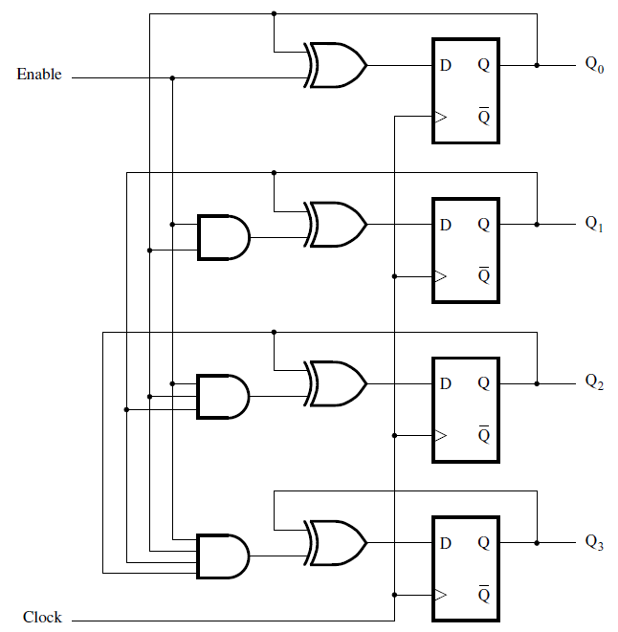
A faster 4-bit counter
[ Figure 5.75 from the textbook ]

Slide 91
Faster 4-bit Counter
Longest path: Q0 to Q3
Tmin = tcQ0 + tAND + tXOR + tsu
=1.0 + 1.4 + 1.2 + 0.6 = 4.2ns
Fmax = 1/4.2ns = 238.1MHz > 156.25MHz

Slide 92
Reaction Timer Circuit
(Section 5.14)

Slide 93
Problem Statement
Want to design a reaction timer
Circuit turns on light (LED)
Person then presses switch
Measures time from LED on until the switch is pressed

Slide 94
Clock Divider
Input: 102.4kHz
Output: 100Hz
10-bit Counter to divide
Output Frequency = 102.4k / 2^10 = 100Hz

Slide 95
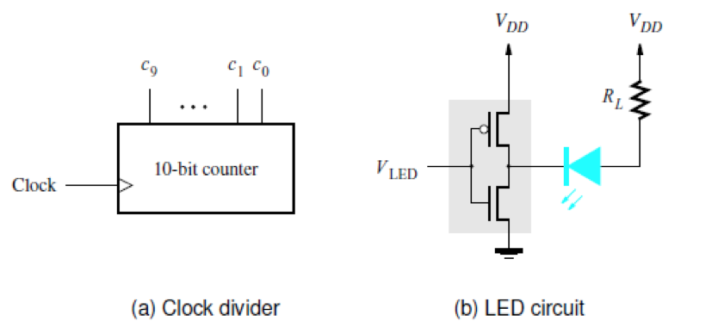
A reaction-timer circuit
[ Figure 5.61 from the textbook ]

Slide 96
Functionality of circuit
  Push switch
    Nominally 1
  DFF to keep track of the state
  Two-digit BCD counter
    Output goes to converters to a 7-segment display
  Start-up
    Assert the Reset signal
      Clears counter
      Clears flip-flop
    Assert w=1 for one cycle
    Once switch is hit
      Clears flip-flop
      Stops counting

Slide 97
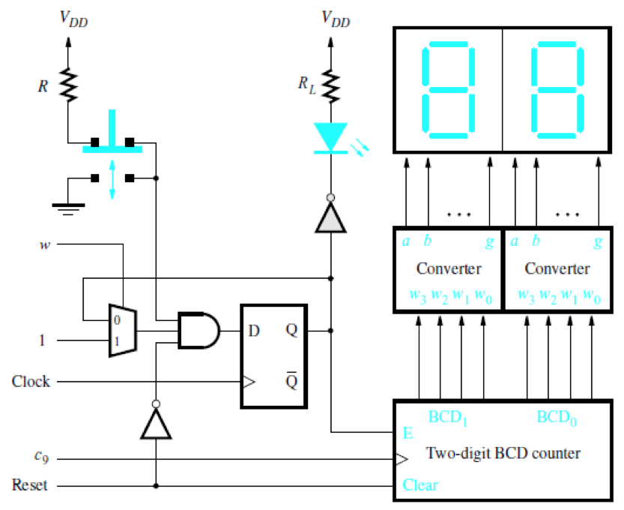
Push-button switch, LED, and 7-segment displays
[ Figure 5.61c from the textbook ]

Slide 98
Examples of Solved Problems
(Section 5.17)

Slide 99
Example 5.18

Slide 100
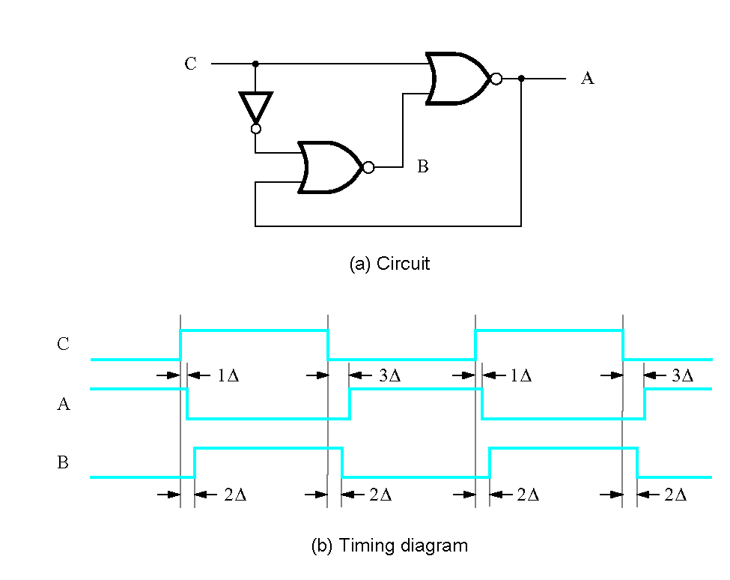
Figure 5.70. Circuit for Example 5.18.

Slide 101
Example 5.19

Slide 102
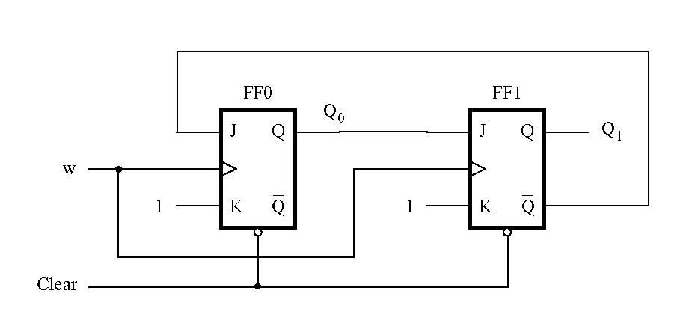
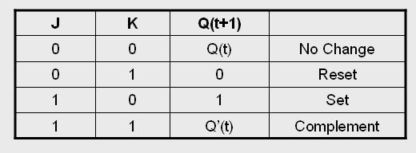
Figure 5.71. Circuit for Example 5.19.

Slide 103
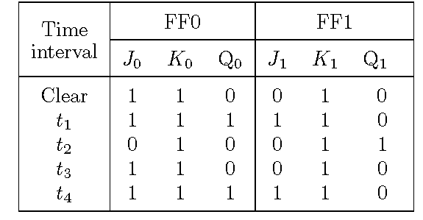
Figure 5.72. Summary of the behavior of the circuit in Figure 5.71.

Slide 104
Example 5.20

Slide 105
Vending machine example
Inputs N, D, Q, Coin, Resetn
  N, D, Q: nickel, dime, quarter
  Coin: pulsed when a coin is entered
    Used to store values into register
  Resetn: resets the register value to zero
Add up new coin with old value
  Store new sum into old value register
See if total is above thirty cents
  If so output Z goes high

Slide 106
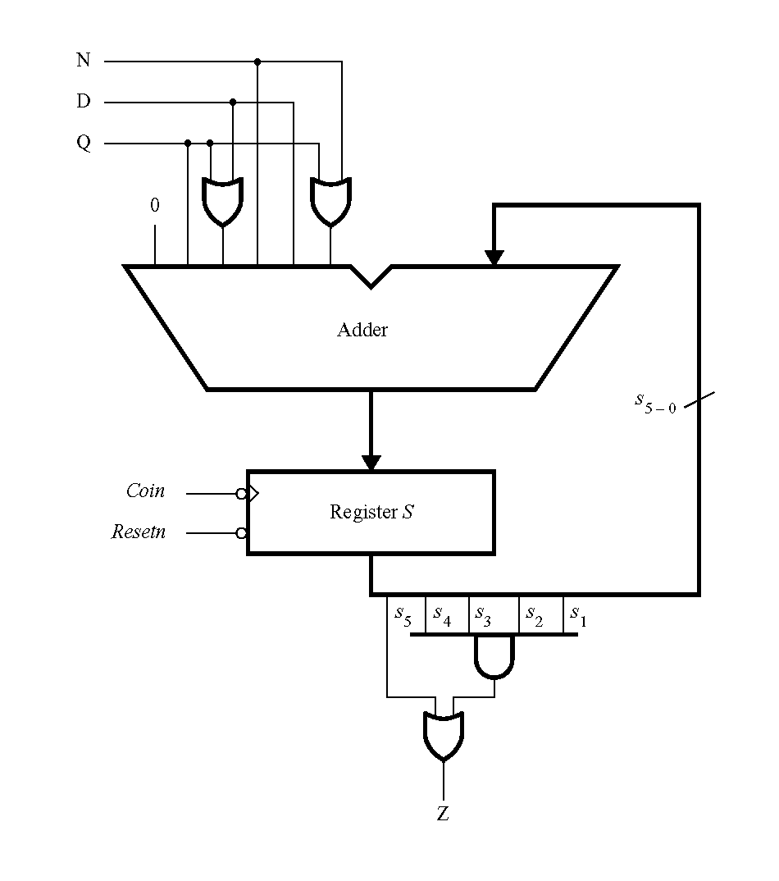
Circuit for Example 5.20
[ Figure 5.73 from the textbook ]

Slide 107
Questions?

Slide 108
THE END

